Slide 1
BIDDING system

Slide 2
Team Member
Shajibul Hasan Soaib – 2104010202166
Meherun Nesa Mumu – 2104010202169
Umme Salma Mumu – 2104010202170
Abdul Mutaleb - 2104010202174

Slide 3
Outlines
Introduction
Motivation
Features
Methodology
Limitations and future works
Conclusion
References

Slide 4
Introduction
A software solution to facilitate online bidding processes.
To create a platform where users can place bids on various items in real-time.
Built using Laravel, with a user-friendly interface.

Slide 5
Motivation
Why a bidding system?
Real-world applications: auctions, e-commerce platforms.
Importance of efficient bidding mechanisms.
Benefits for users: secure, real-time bidding, transparency, etc.

Slide 6
Features
Separate dashboard for each user
Separate dashboard for admin
Users can create bids, but they will run only after admin approval.
Users will be able to participate in the bid.
Users will be able to update their profiles.
Secure user authentication system

Slide 7
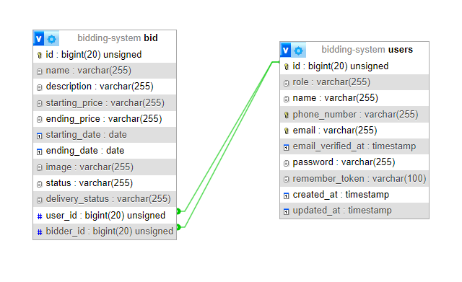
Methodology
DB Design

Slide 8
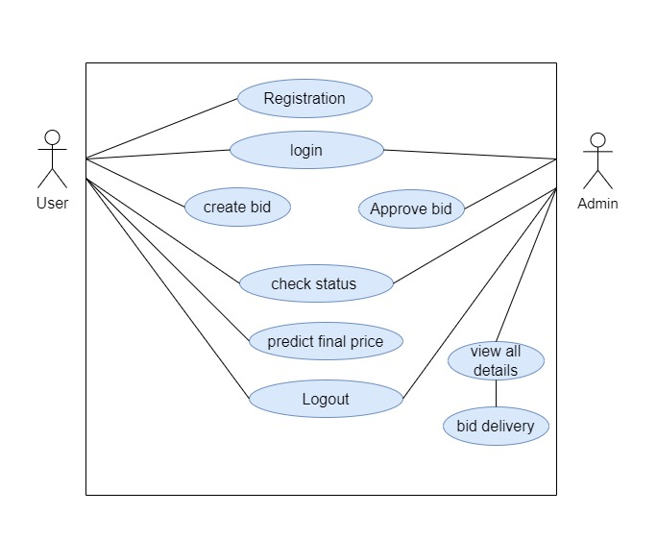
Methodology
Use Case Diagram

Slide 9
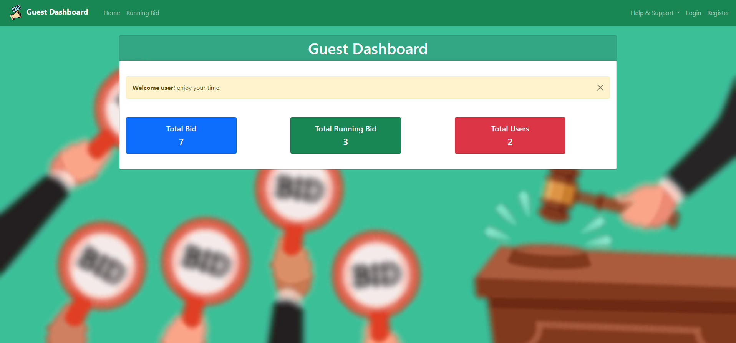
Guest Dashboard

Slide 10
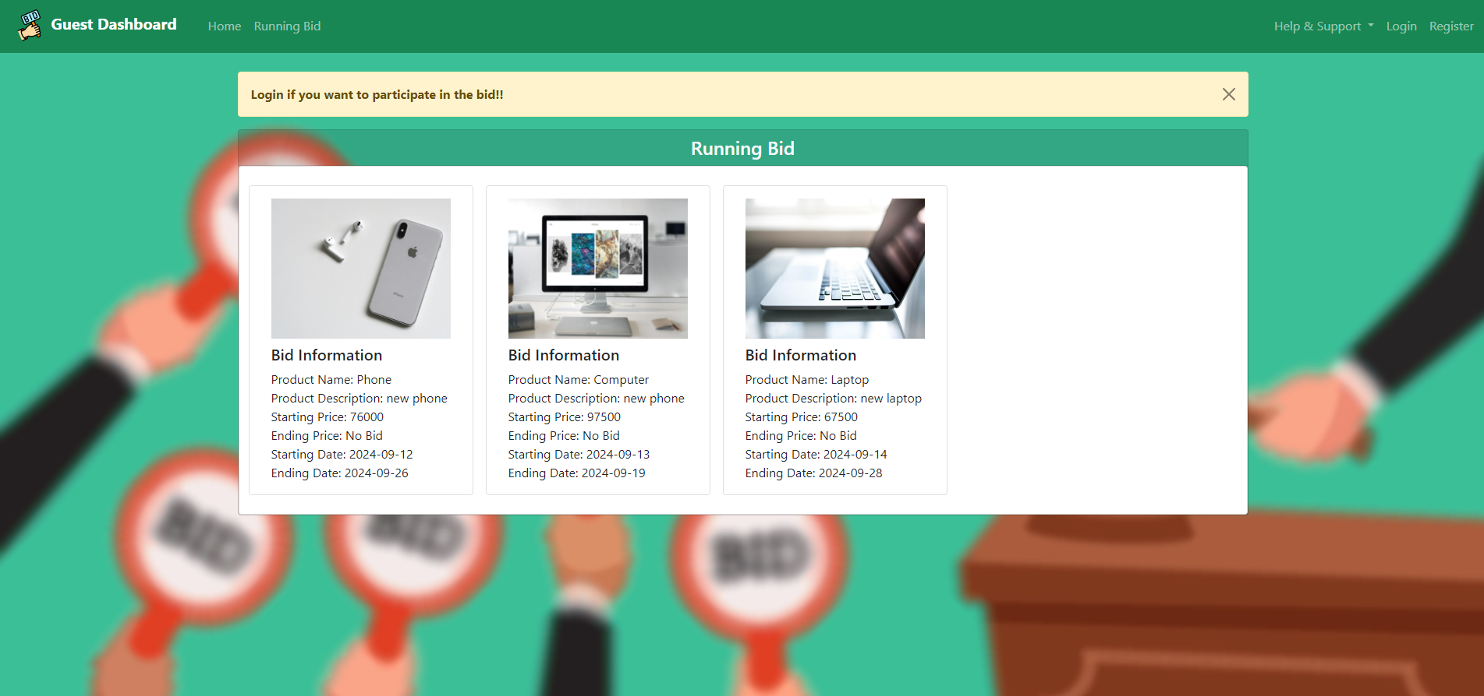
RUNNING bID

Slide 11
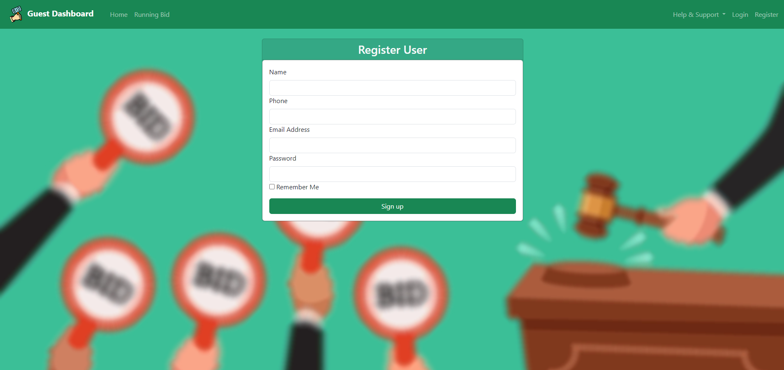
Registration

Slide 12
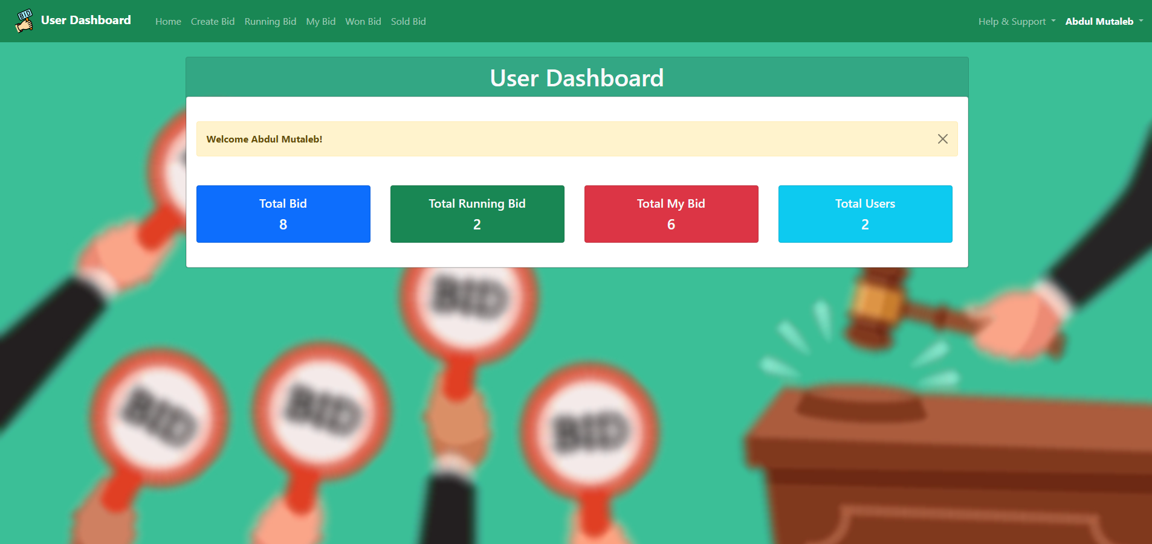
User Dashboard

Slide 13
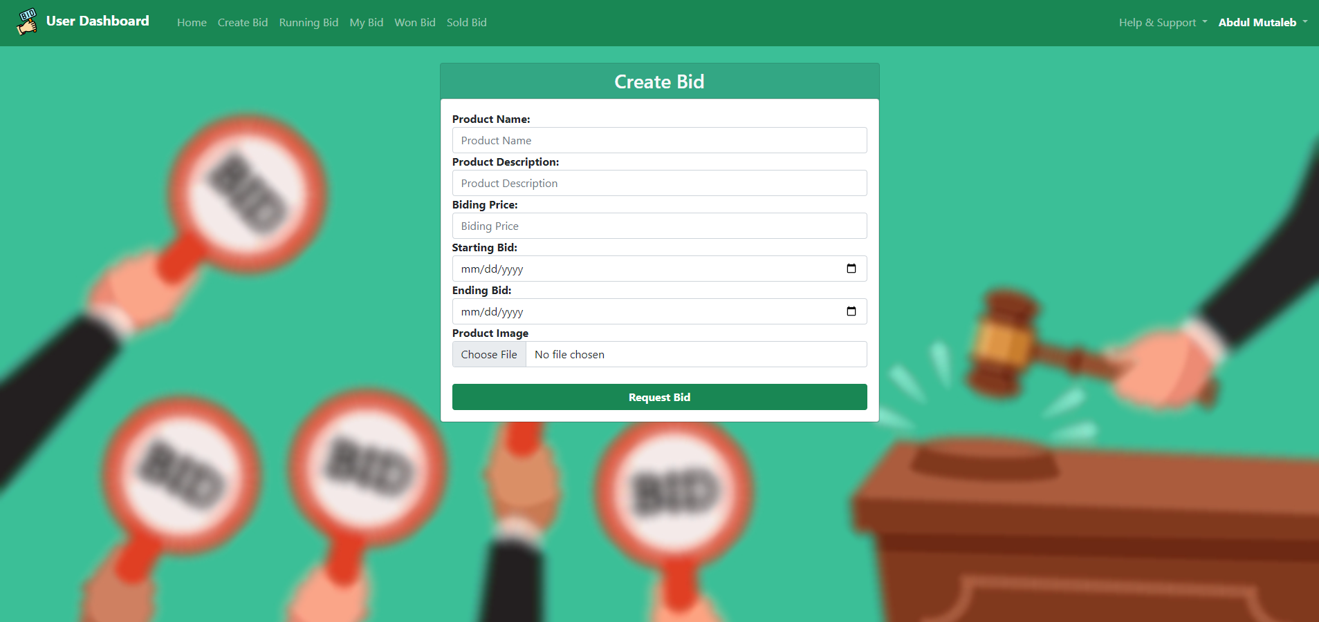
Create Bid

Slide 14
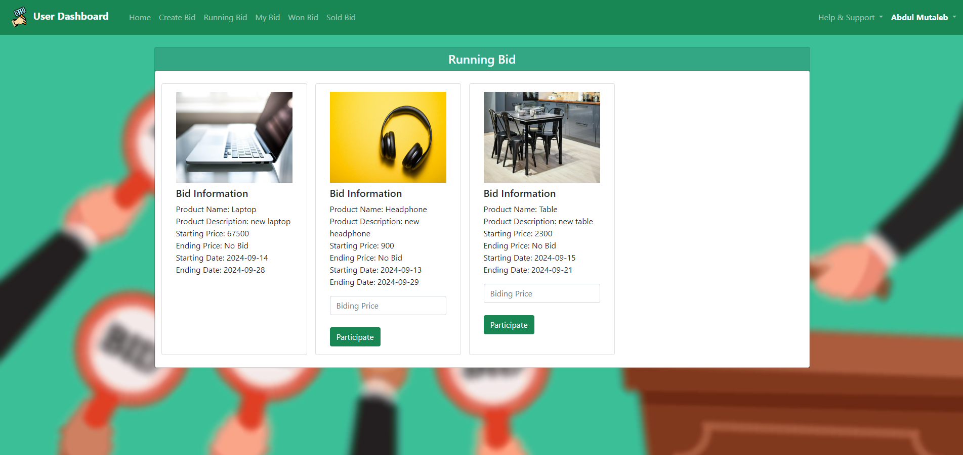
Running Bid

Slide 15
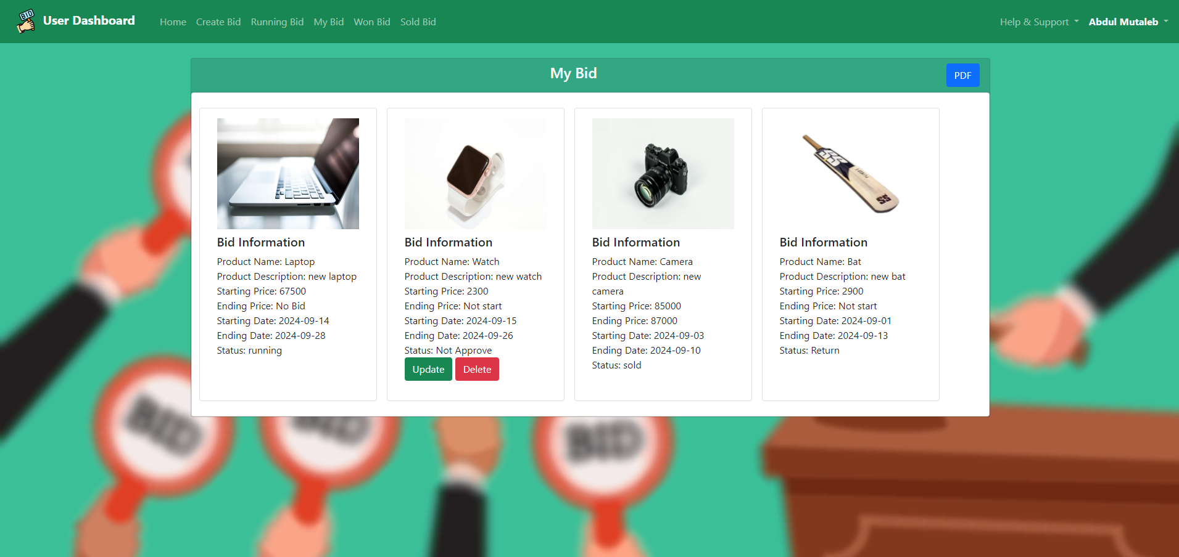
My Bid

Slide 16
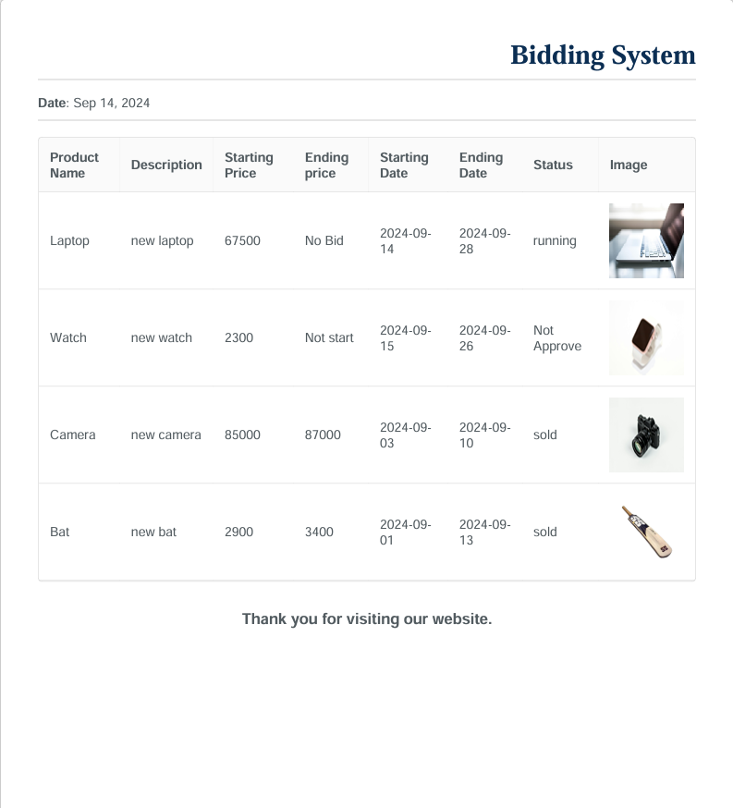
PDF

Slide 17
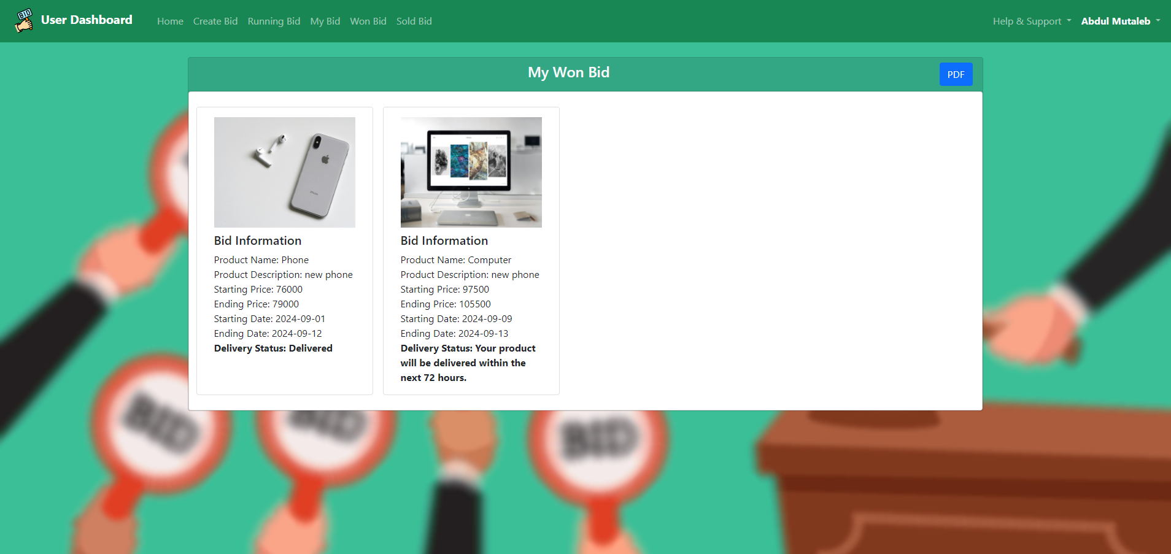
Won Bid

Slide 18
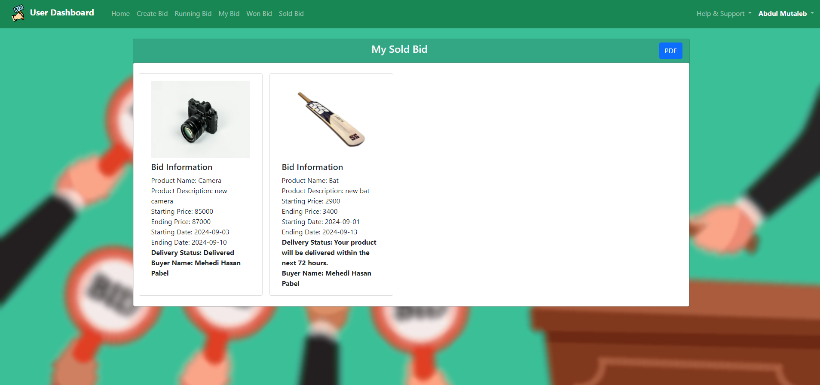
Sold Bid

Slide 19
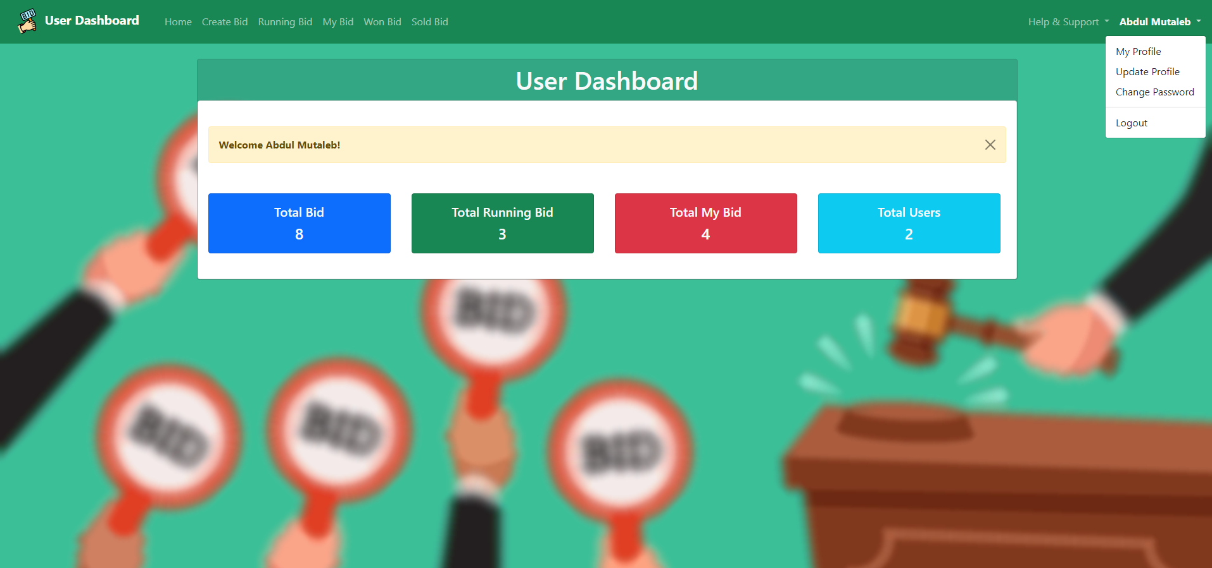
Settings

Slide 20
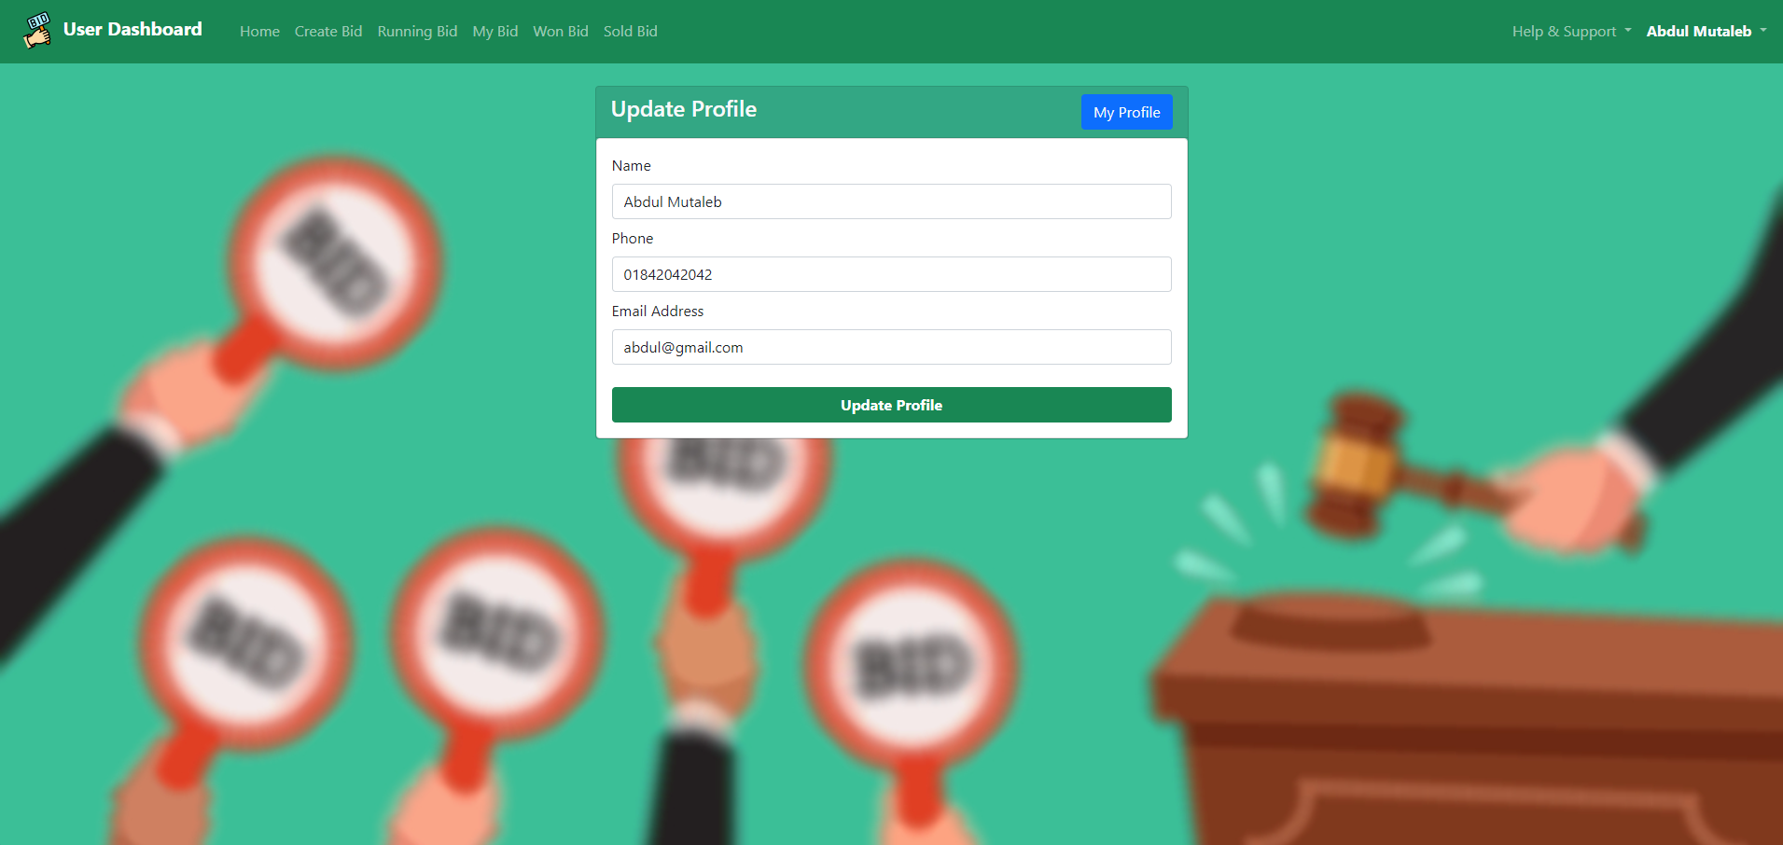
UPDATE profile

Slide 21
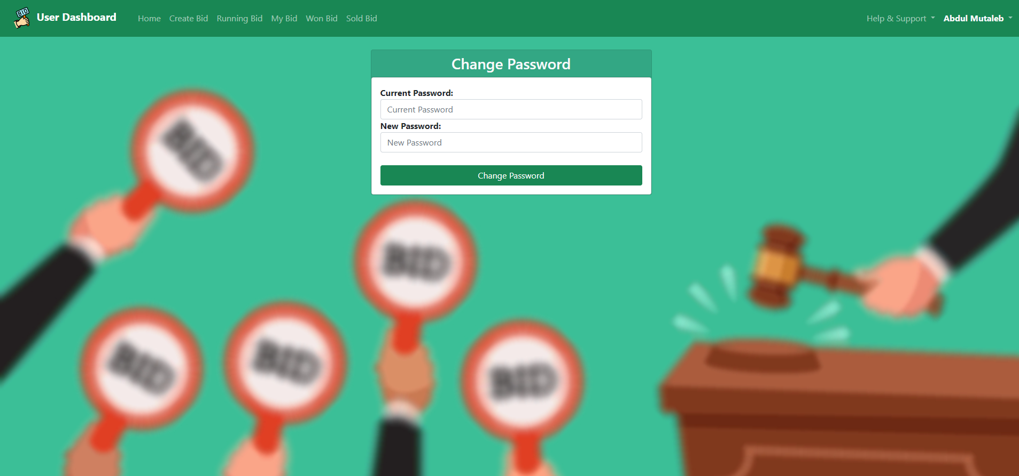
Change password

Slide 22

Admin dashboard

Slide 23
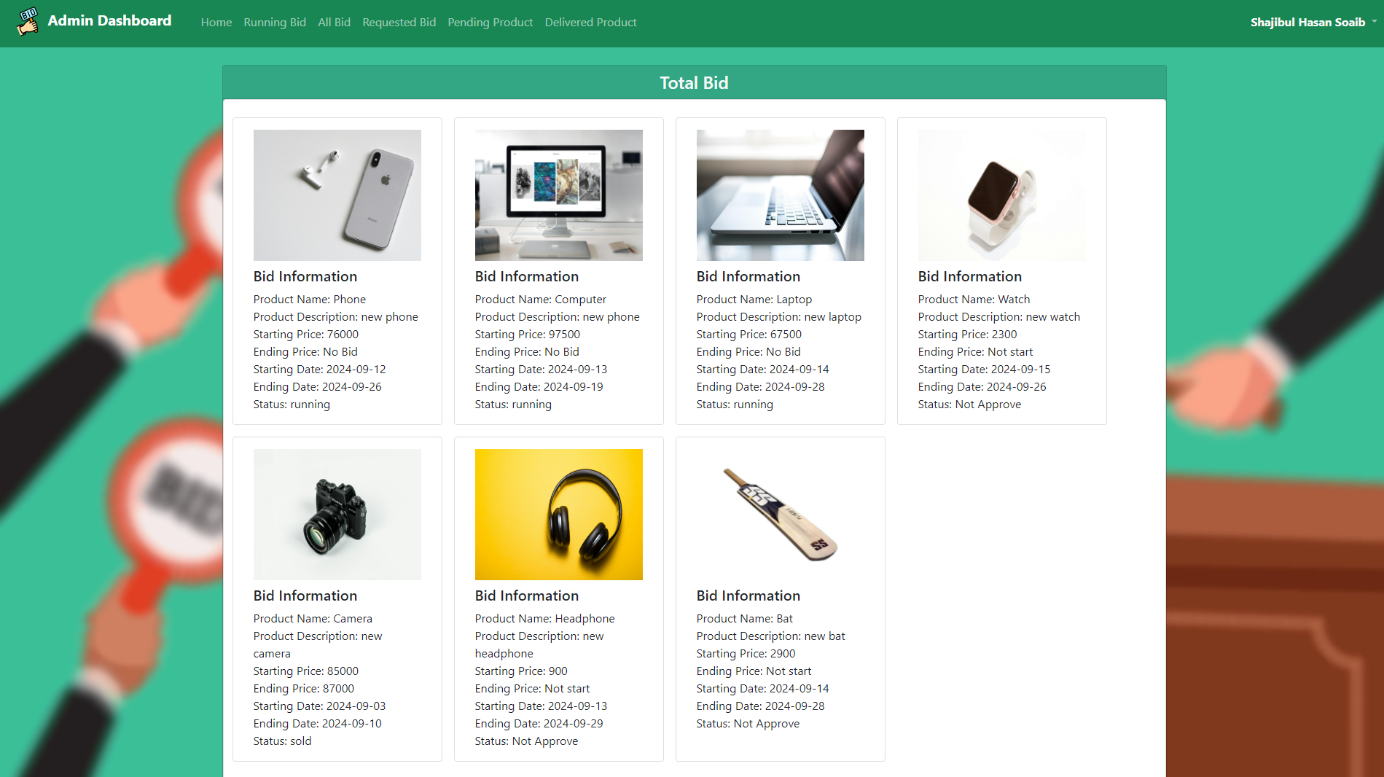

Slide 24
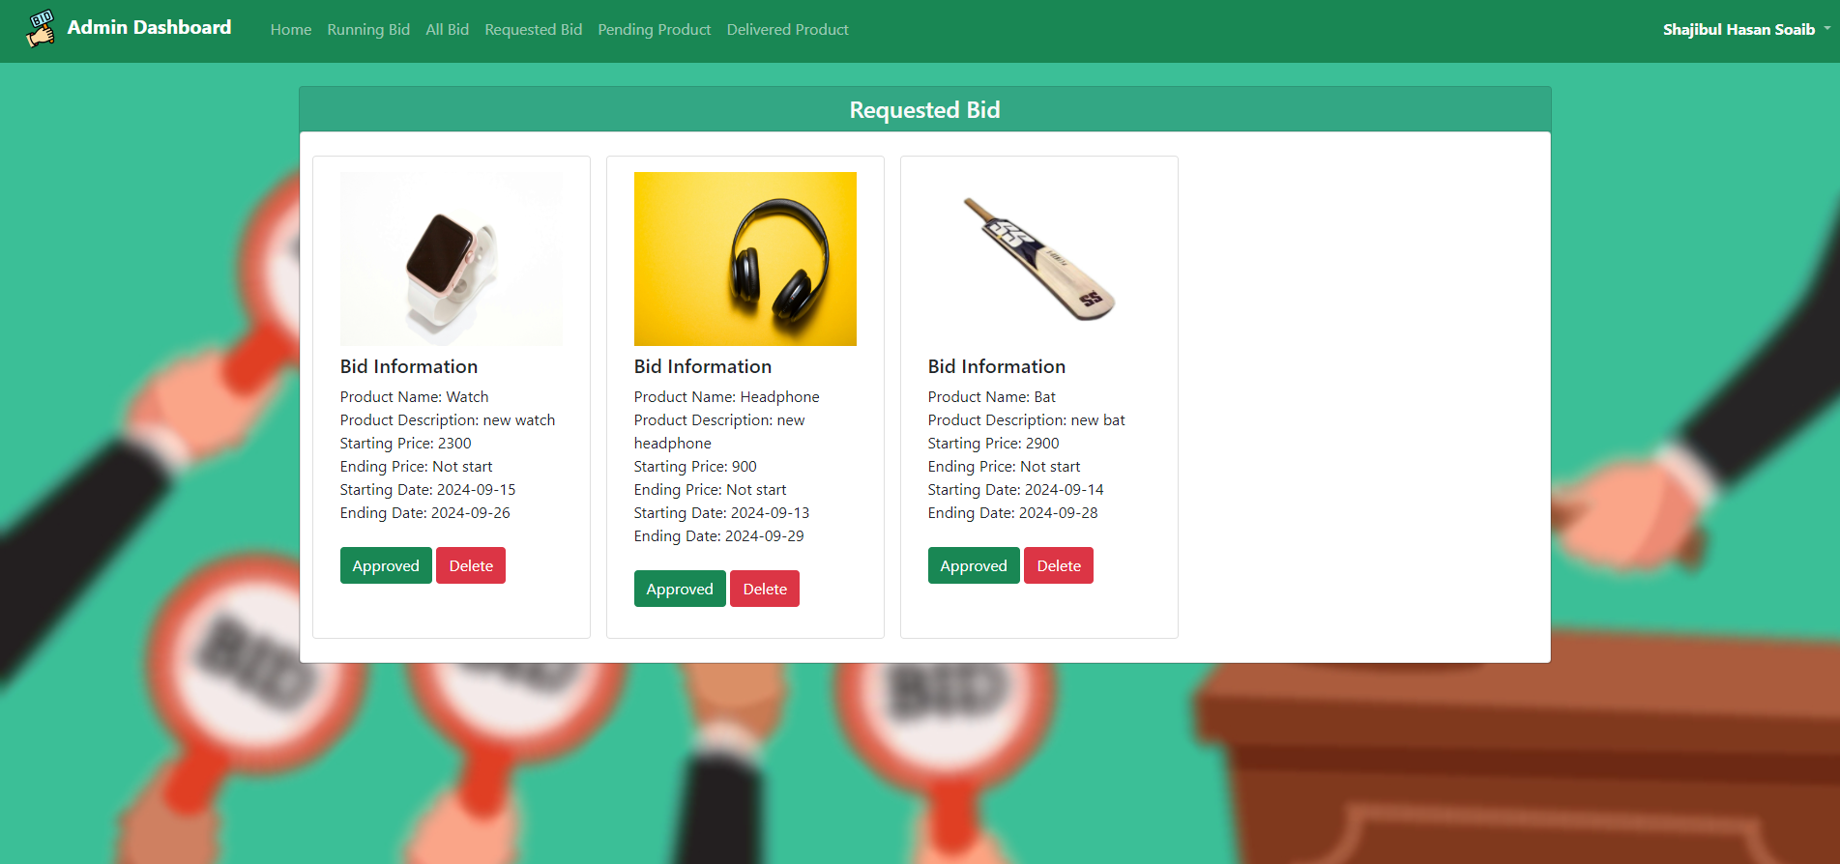
Requested Bid

Slide 25
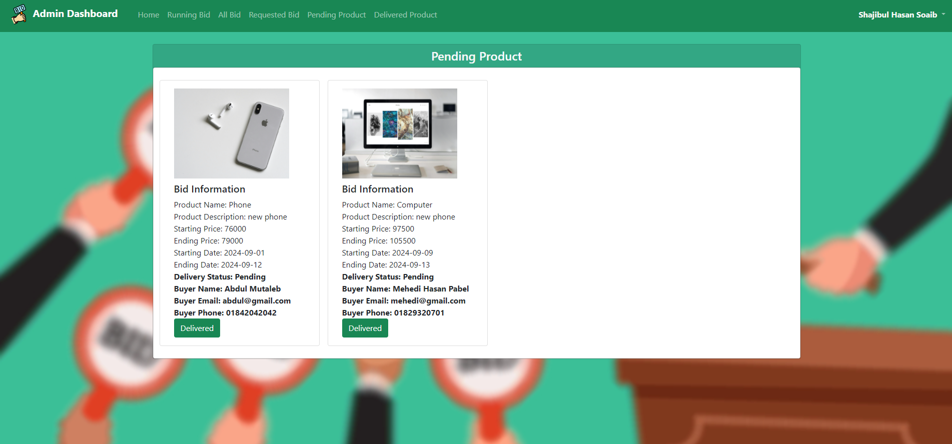
Pending product

Slide 26
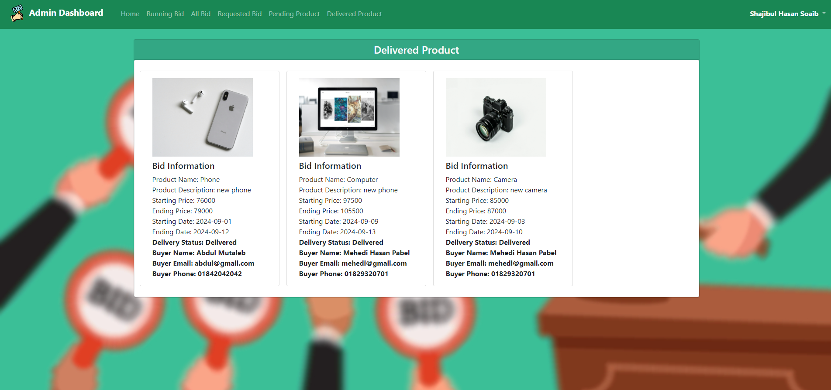
Delivered product

Slide 27
Limitations and future works
Current limitations of the system:
No limited to specific types of bids or items.
Mobile application.
Future improvements:
Add real-time notifications via SMS or app.
Develop a mobile version for broader accessibility.

Slide 28
Conclusion
Developed a functional bidding system with core features.
Further enhancements will increase usability and reach.
Acknowledgment of challenges and solutions implemented.

Slide 29
References
Books & Articles:
Software Engineering: A Practitioner's Approach" by Roger S. Pressman
Database System Concepts" by Abraham Silberschatz, Henry F. Korth, S. Sudarshan
Web Resources:
Official MySQL Documentation: https://dev.mysql.com/doc/
HTML & CSS Tutorials: https://www.w3schools.com/
Laravel for Real-Time Applications: https://laravel.com/docs/11.x
Project Resources:
Stack Overflow: Problem-Solving & Code Assistance
GitHub: Project Repository for Version Control

